Slide 1

Introduction
to
Computer Science
CS101.3
Lecture #11

Slide 2

From Last Week
Computer Storage Structure
Optical Disk

Slide 3
Image Representation
Computer-generated images can be stored in several different formats and different resolutions.
All computer files such as numbers, words or graphics are stored in digital formats
When representing images what computer do is translate the image into digital code for storage and then interpret the file back into an image for display

Slide 4
Digital Image Sources
Digital Cameras
Scanned Film & Photograph
Digitalized TV Signals
Computer Graphics
The Internet

Slide 5
Pixel
Computer graphics often involves with pixels
A pixel is one of the very small dots creating the image on your computer screen
Arranging pixels in certain patterns produces the illusion of color
A single pixel is one byte of information

Slide 6
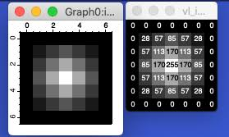
Pixels and Pixel Values
Pixel – an element of the 2D image array
The most common pixel format is the byte image
In byte image number is stored as an 8-bit integer giving a range of possible values from 0 to 255.
Typically, zero is taken to be black and 255 is taken to be white

Slide 7
Digitalizing Images
Images are digitized using a two-step process
01. Sampling the continuous tone image
02. Quantizing pixels

Slide 8
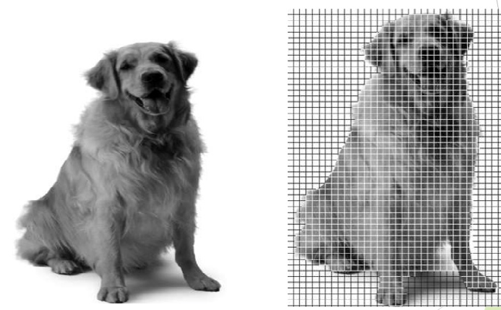
Sampling Images

Slide 9
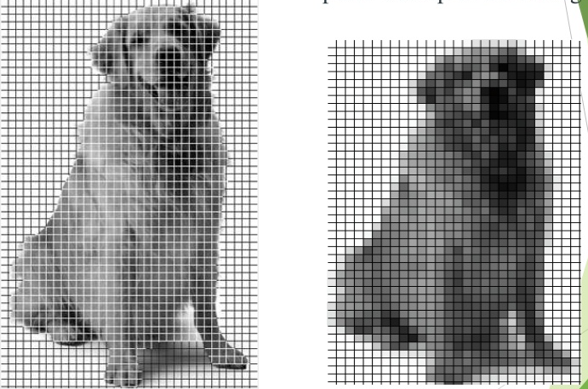
Quantization

Slide 10
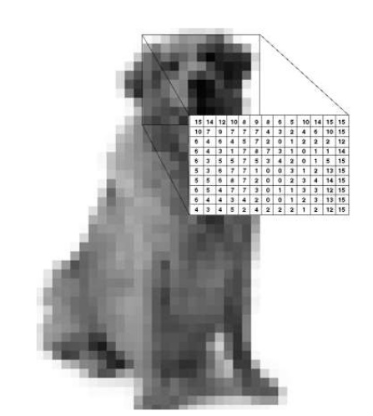
Quantization Example

Slide 11
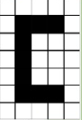

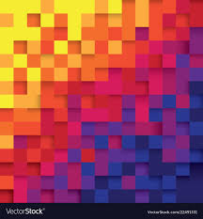
Types of Images
Pixel Values
Binary Images ( Pixel Values = 0,1 )
Grayscale Images ( Pixel Values = 0 – 255 )
Color Images
Each Pixel has three color components
for example (red, green, blue ) or RGB
Each color component is 0 - 255

Slide 12
Image Resolution
Resolution refers to the number of pixels in an image
Resolution is sometimes identified by the width and height of the image as well as the total number of pixels in the image.
For an example, an image that is 2048 pixels wide and 1536 pixels high ( 2048 x 1536 ) contains 3,145,728 pixels or 3.1 Megapixels

Slide 13
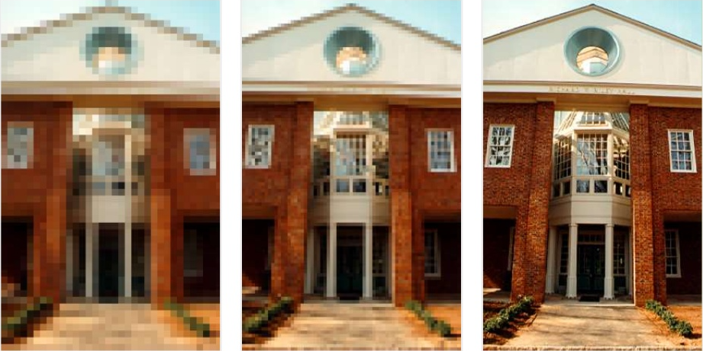
Image Resolution
68 x 104
Less Detail
Less storage
136 x 208
272 x 416
More Detail
More storage

Slide 14

Story of a Digital Image

Slide 15
Storing Digital Images
Digital images are converted to files for storage and transfer
The file type is a special format for ordering and storing the bytes that make up the image
File types or formats are not necessarily compatible
You must often match the file type with the application

Slide 16
Storing Digital Images
File Types
GIF ( Graphic Interchange Format )
JPEG (Joint Photographic Experts Group)
PNG ( Portable Network Graphics)
BMP

Slide 17
How many bytes to store an Image
Assume that we have an image that is 500 x 500 pixels in size
Total Resolution = 250,000 pixels
Binary Image ( 1 bit / Pixel ) = 31,250 bytes
Grayscale Image ( 8 bits / Pixel ) = 250, 000 bytes
Color Image ( 24 bits / Pixel ) = 750,000 bytes

Slide 18
Task 01
Assume that we have an image that is 400 x 600 pixels in size
Find the number of resolution
How many bytes need to store the binary image?
How many bytes need to store the grayscale image?
How many bytes need to store the color image?

Slide 19
Revision
A magnetic disk have 12 platters, 5000 tracks on each surface and 20 sectors per track. The capacity of a sector is 3KB
Find the capacity of a track
Find the Capacity of a surface
Find the capacity of the total HDD
Find the capacity of a cylinder

